Slide 1
ETEC692
Practicum in Educational Technology
Eman Almasruhi

Slide 2
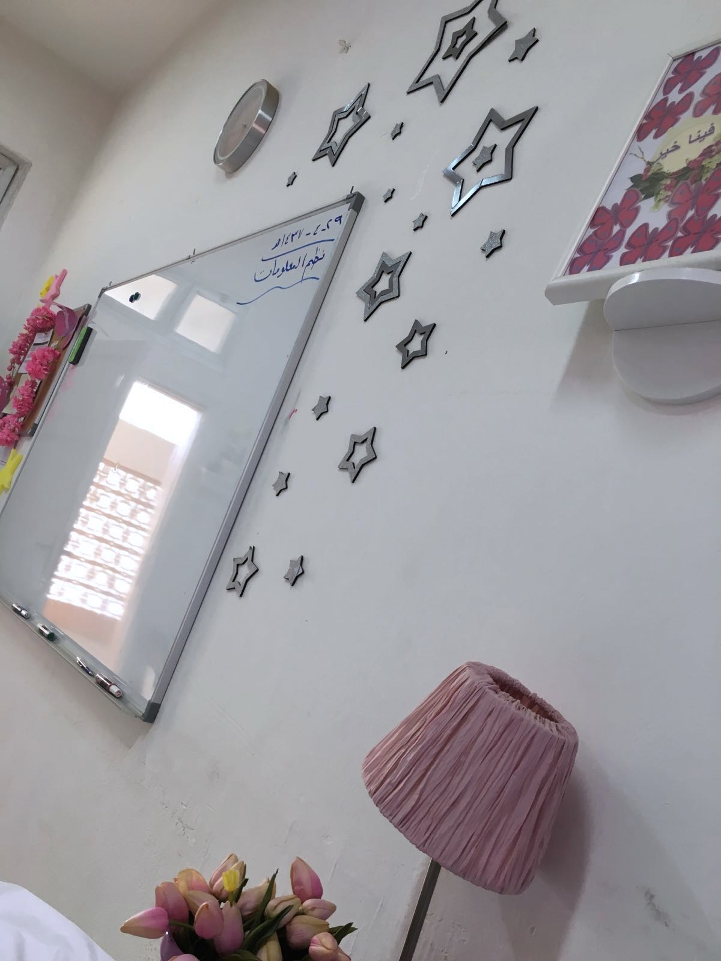
Helping Teacher in the Class
I worked with computer teacher in high school by helping her students when they work in computer.
Using Excel and Word.

Slide 3
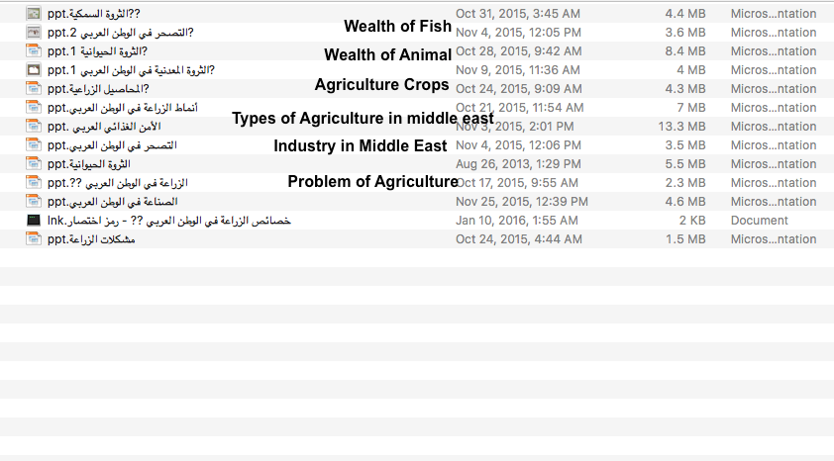
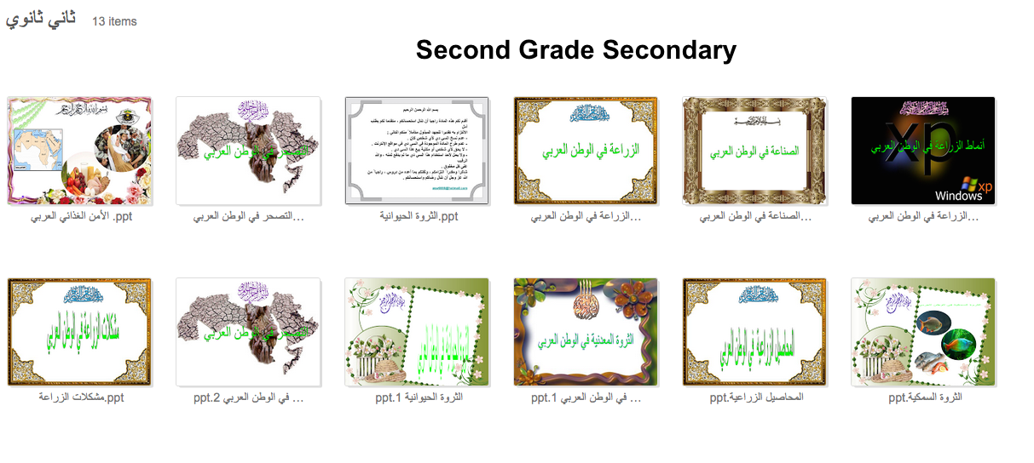
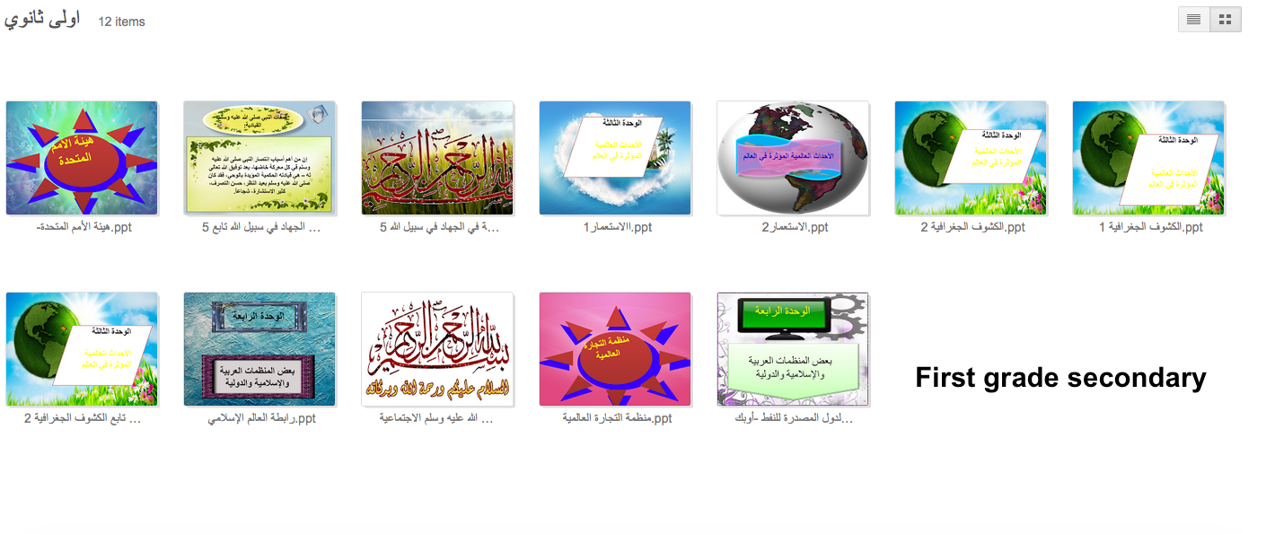
Design Materials
Designing lessons For different classes and Topics by using Power Point. E.g. geography and history.

Slide 4
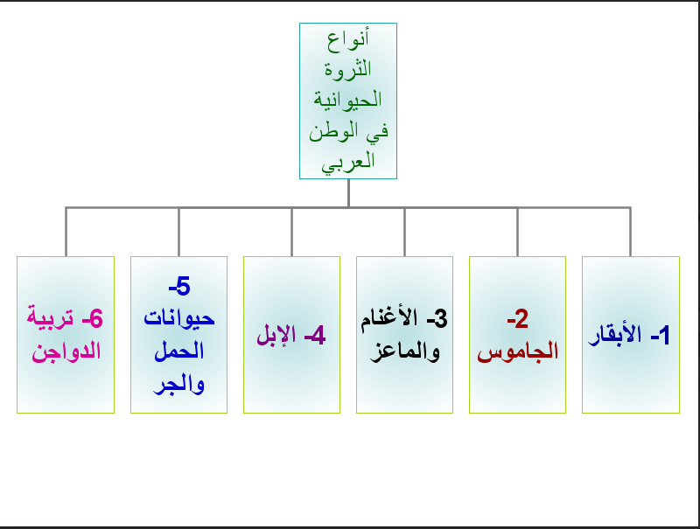
Pictures for my works

Slide 5
Participated in Activities
Participating in activities that school offered “ Protect your School”
Doing Flyers and brochures for the activities.
Assisting Educational Supervisor in designing presentation.

Slide 6
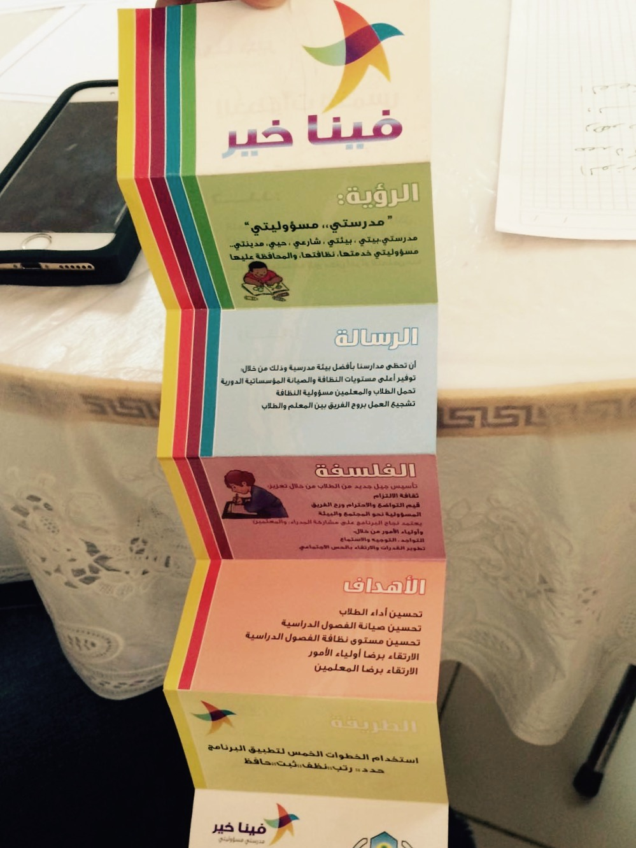
Pictures for the Activities

Slide 7
My Benefit of this Experience
Developed my skills
Gaining confidence
Opinions.

